Slide 1

Data Engineering
Week Two

Slide 2



What is Data Engineering?
Data Engineering Tools
What does a data engineer do?
Data Analyst & Data Engineer - What’s the difference?
Data Engineering Activities and Deliverables
Hierarchy Of Demands In Data Science
Comparing Data Management Roles
Data Engineer Skill Set
Data Engineer vs. Database Engineer
Data Engineer vs. Software Engineer
Data Engineers as Collaborators
Data Engineer Role
Data Engineer Responsibilities
Data Engineer vs. Data Scientist

Slide 3


What is Data Engineering?
Big data is changing the way we do business and creating a need for data engineers who can collect and manage large quantities of data.
Data engineering is the practice of designing and building systems for collecting, storing, and analyzing data at scale. It is a broad field with applications in just about every industry.
Organizations have the ability to collect massive amounts of data, and they need the right people and technology to ensure it is in a highly usable state by the time it reaches data scientists and analysts.

Slide 4
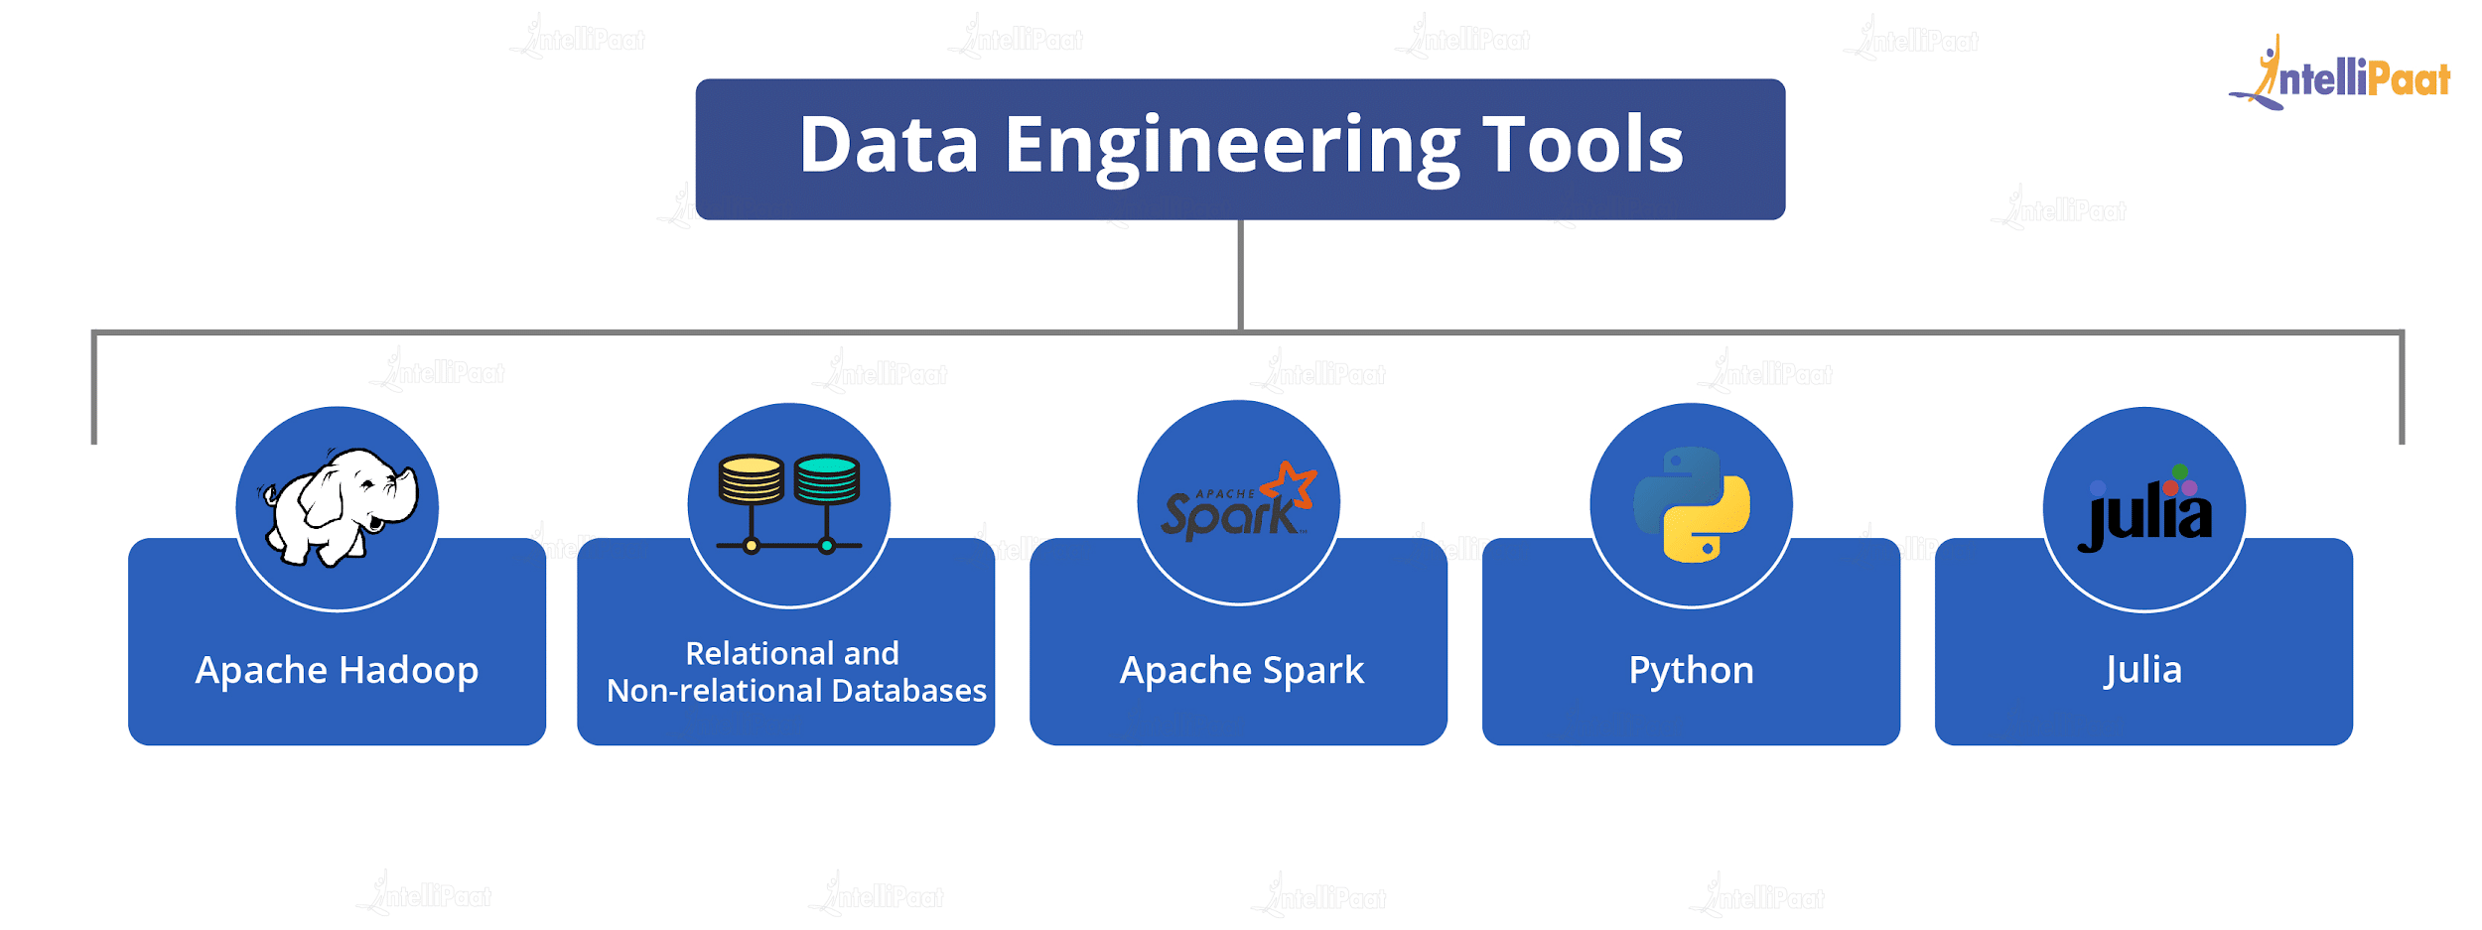
Data Engineering Tools
The Data Engineering basics revolve around the typical Data Engineering tools that find their usage in the daily life of a Data Engineer.
Apache Hadoop: Hadoop is a collection of tools, namely, HDFS (Hadoop Distributed File System), MapReduce, etc. It acts as a foundation framework for storing and analyzing information.
Relational and non-relational databases: SQL and NoSQL act as the basic tools for executing Data Engineering applications. They are known for handling enormous amounts of real-time unstructured and polymorphic data.
Apache Spark: It is used for stream processing and batch processing. It is 100x quicker than MapReduce and is estimated to replace MapReduce in the Hadoop Ecosystem soon.
Python: It is the most popular general-purpose language used for statistical analysis. A majority of Data Engineer job descriptions mention ‘fluency in Python’ as a mandatory requirement.
Julia: Julia is yet another general-purpose programming language that is easy to learn. It has the capability to be used solely in data engineering projects for prototyping and production.

Slide 5
What does a data engineer do?
Data engineers work in a variety of settings to build systems that collect, manage, and convert raw data into usable information for data scientists and business analysts to interpret.
These are some common tasks you might perform when working with data:
Acquire datasets that align with business needs
Develop algorithms to transform data into useful, actionable information
Build, test, and maintain database pipeline architectures
Collaborate with management to understand company objectives
Create new data validation methods and data analysis tools
Ensure compliance with data governance and security policies

Slide 6
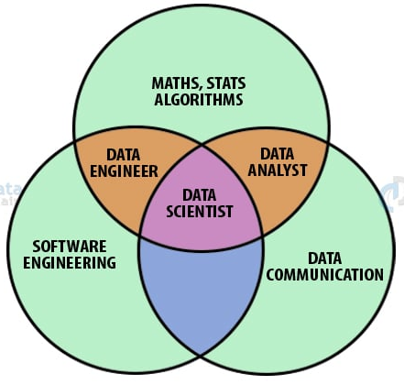
Data Analyst & Data Engineer - What’s the difference?
Data scientists and Data analysts analyze data sets to glean knowledge and insights.
Data engineers build systems for collecting, validating, and preparing that high-quality data. Data engineers gather and prepare the data and data scientists use the data to promote better business decisions.

Slide 7
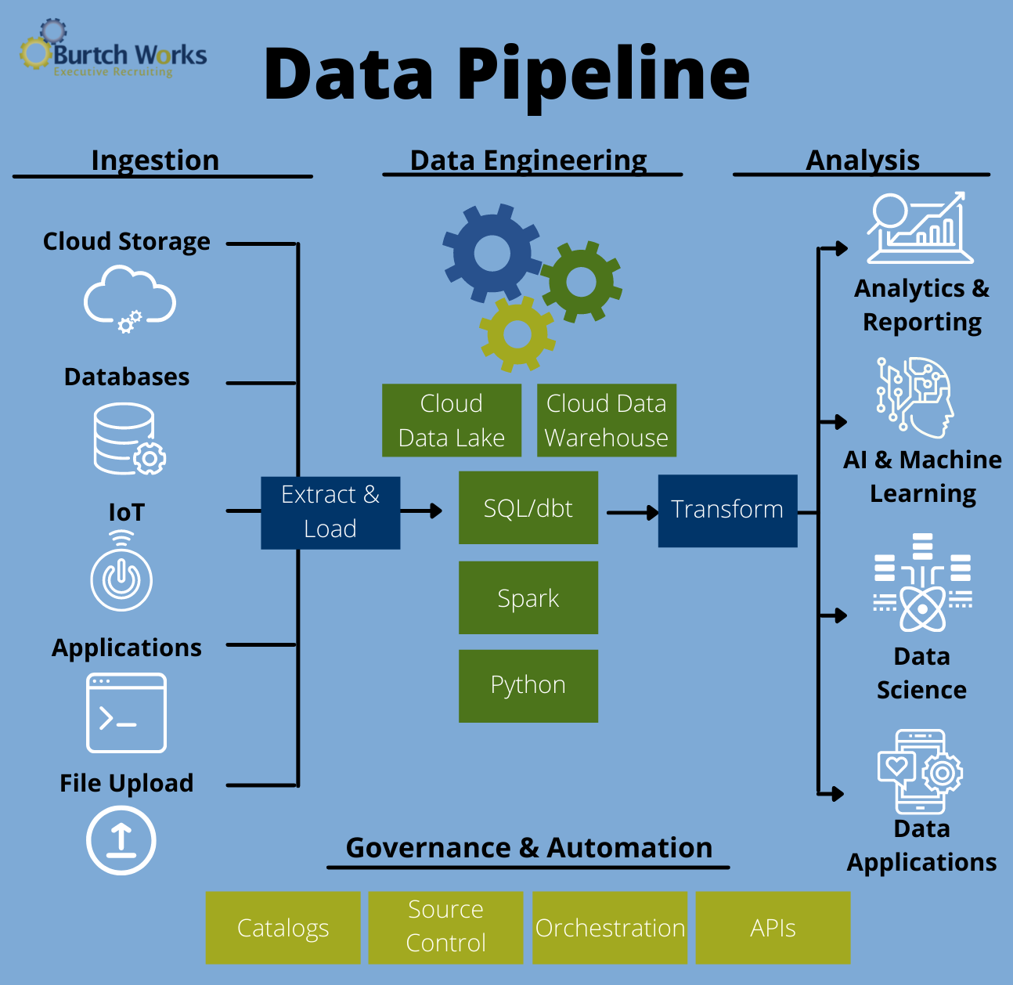
Data Engineering Activities and Deliverables
Data engineer is a demanding job that requires both breadth and depth.
Breadth of knowledge ranges from relational databases to NoSQL, from batch ETL to data stream processing, and from traditional data warehousing to data lakes.
Depth of skills includes hands-on working with Hadoop, programming in Java or Python, and data modeling from star schema to document stores and graph databases.
The Data engineer is part …
Database engineer building the databases that implement data warehouses and data lakes
Software engineer building the processes, pipelines, and services that move data through the ecosystem and make it accessible to data consumers.

Slide 8
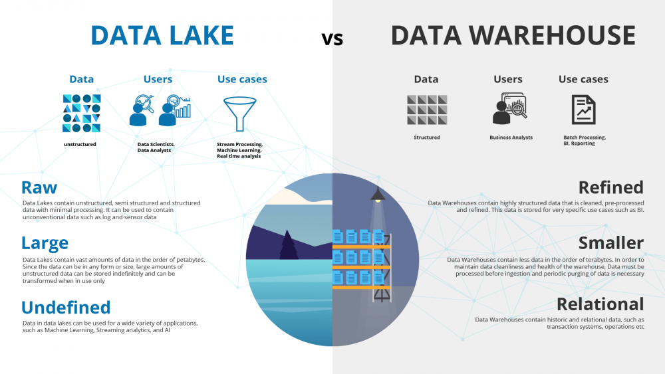
Data Engineering Activities and Deliverables
Data lake is a centralized repository that allows organizations to store and manage vast amounts of raw data in various formats, including structured, semi-structured, and unstructured data.
Unlike traditional data warehouses, which often require data to be pre-processed and structured before being ingested, data lakes provide a more flexible and scalable approach to data storage and analysis.

Slide 9
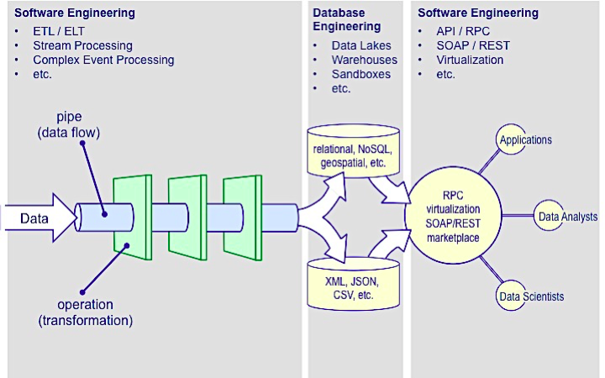
Data Engineering Activities and Deliverables

Slide 10
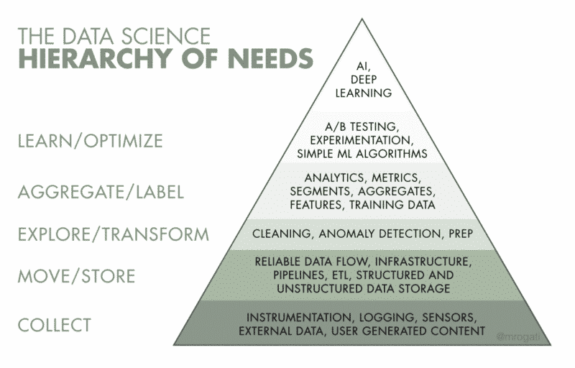
Hierarchy Of Demands In Data Science
If we look at the hierarchy of demands in data science implementations, we can see that data engineering is the next stage after acquiring data for analysis (Data Engineer’s role is at level 2 and 3),
It’s worth noting that the bottom level “collect” is growing larger and larger, thereby driving the need for more Data Engineers.
As if it allows for efficient data storage and dependable data flow while also managing the infrastructure.
Without data engineers to analyze and channel that data fields like machine learning and deep learning won’t prosper.

Slide 11
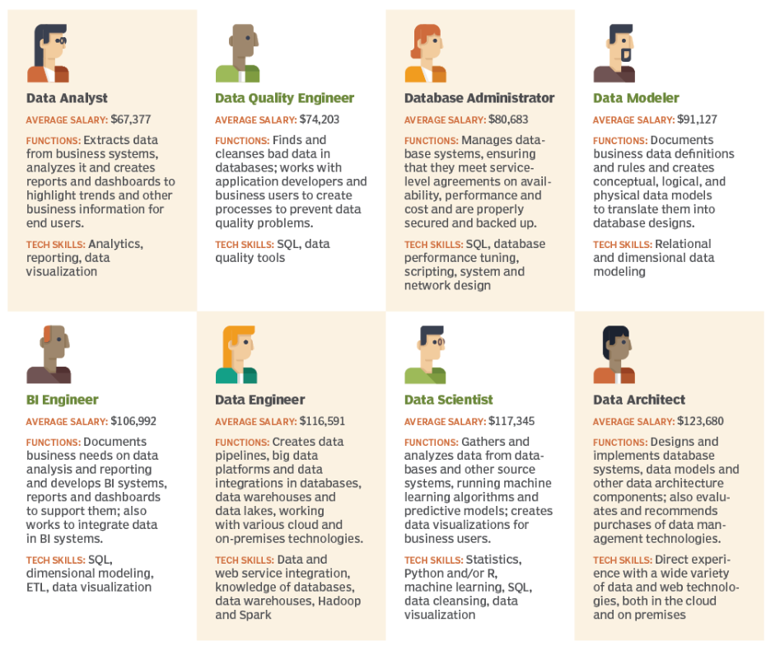
Comparing Data Management Roles
Michael Bowers, chief architect at Faircom corp., mapped how data management roles differ in salary, functions and skills, based on data from job sites and his personal experience.

Slide 12
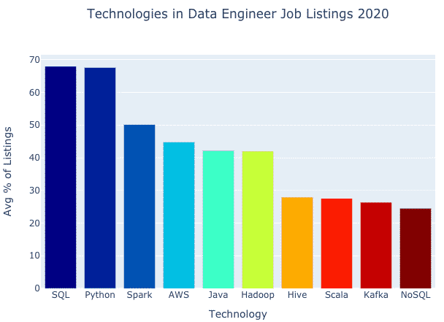
Data Engineer Skill Set
Data engineers are skilled in programming languages such as C#, Java, Python, R, Ruby, Scala and SQL.
These tools are constantly changing, and it varies by industry.
Some, such as SQL, have been around forever.

Slide 13
Data Engineer Skill Set
Important skill areas are:
Foundation software engineering – Agile, devOps, architecture design, service-oriented architecture.
Distributed systems – This would include software engineer skills and software architect skills.
Open Frameworks – Apache Spark, Hadoop, perhaps Hive, MapReduce, Kafka and others…
SQL – This is a database staple and remains that way.
Programming – Python has become the favored language for working with data. Java on the other hand, while still widely sought has fallen out of favor with most data scientists and engineers. Scala is another language that Apache Spark and Kafka are based on.
Pandas – a Python library for cleaning and manipulating data.
Visualization/dashboards

Slide 14
Data Engineer Skill Set
Cloud platforms – AWS is probably the most prevalent cloud skill set for Data Engineers to know. Google Cloud Data Engineering and Microsoft Azure are right behind.
Analytics – While mainly the realm of data scientists, statistical analysis skills or understanding of some of the different mathematical principles or probabilistic principles are necessary for being able to properly manipulate the data so that it is in a shape that is accessible for the people who are doing the end analysis on it.
Data modeling – Data modeling knowledge is quite important now in the sense that a Data Engineer needs to know how they are going to structure tables, partitions, where to normalize and denormalize data in the warehouse, etc. and how to think about retrieving certain attributes.

Slide 15

Data Engineer vs. Database Engineer
Database Engineers are responsible for designing, implementing, and maintaining the databases that power businesses and other organizations.
They work with Database Administrators to ensure that databases are up to date and free of errors.
Database Engineers also work with software developers to ensure that new applications are compatible with existing databases.
In addition, they may be responsible for developing new database applications or modifying existing ones.
Database Engineers typically have a bachelor’s degree in computer science or a related field.

Slide 16
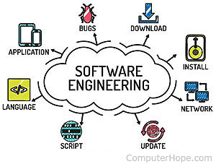
Data Engineer vs. Software Engineer
The biggest difference between data engineering and software engineering is the scope of work.
Data engineers build data systems and databases while software engineers create applications, software, and other products.
A data engineer typically works with big data to create the infrastructure so data analysts, data scientists, and business analysts can maneuver the data for their specific needs.

Slide 17
Data Engineer vs. Software Engineer
Data Engineer | Software Engineer
Build data systems and databases that can store, consolidate, and retrieve data | Build systems, applications, websites, and tools
Specialized role | Broader role
Users are data scientists or analysts | Users are general public
Skills include coding and development, optimizing queries, distributed computing, building data pipelines, machine learning | Skills include building operating systems, coding, programming languages, storing information on databases, data modeling
Works with data scientists, business analysts, project managers on a data science team | Works with designers, programmers, and developers
Popular tools include Tableau, Looker, Amazon Redshift, Apache Spark, Kafka, Hadoop, Hive, and more | Popular tools include Git, GitHub, Stack Overflow, Jira, Amazon Web Services, and more

Slide 18
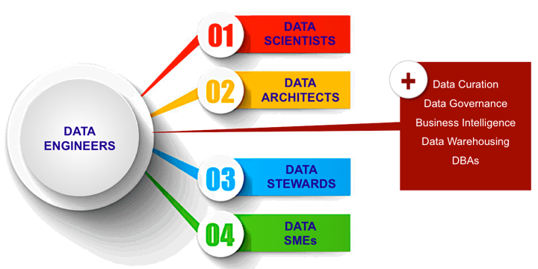
Data Engineers as Collaborators
A team of people with complementary skills is a more practical approach than data engineering silos.
Data engineers need to be team players and they also need to be collaborators working with data scientists, architects, stewards, and subject matter experts (SMEs).

Slide 19
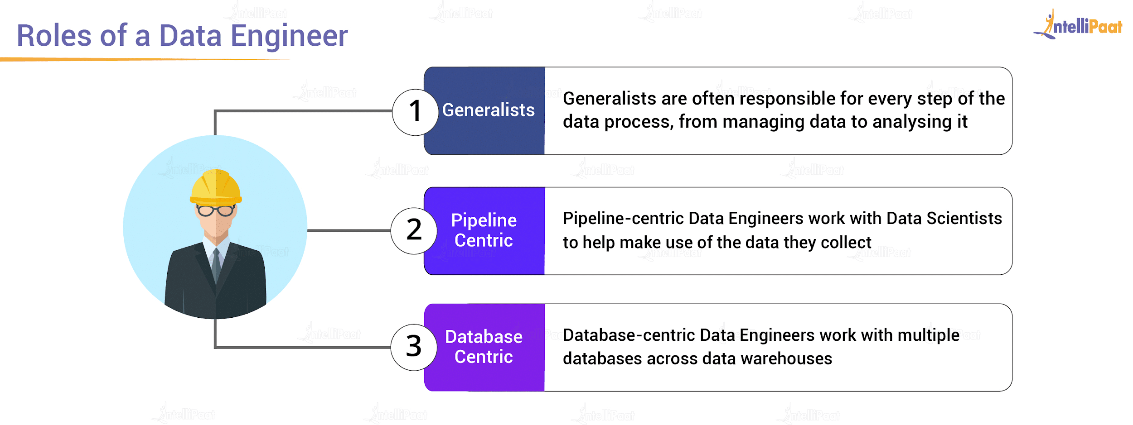
Data Engineer Role
Data engineers focus on collecting and preparing data for use by data scientists and analysts. They take on three main roles as follows:
Generalists
Pipeline-Centric engineers
Database-Centric engineers

Slide 20
Data Engineer Role - Generalists
Generalists:
Data engineers with a general focus typically work on small teams, doing end-to-end data collection, intake and processing.
They may have more skill than most data engineers, but less knowledge of systems architecture. A data scientist looking to become a data engineer would fit well into the generalist role.
A project a generalist data engineer might undertake for a small, metro-area food delivery service would be to create a dashboard that displays the number of deliveries made each day for the past month and forecasts the delivery volume for the following month.

Slide 21
Data Engineer Role - Pipeline-Centric engineers
Pipeline-centric engineers:
These data engineers typically work on a midsize data analytics team and more complicated data science projects across distributed systems.
Midsize and large companies are more likely to need this role.
A regional food delivery company might undertake a pipeline-centric project to create a tool for data scientists and analysts to search metadata for information about deliveries.
They might look at distance driven, and drive time required for deliveries in the past month, then use that data in a predictive algorithm to see what it means for the company's future business.

Slide 22
Data Engineer Role - Database-Centric engineers
Database-centric engineers:
These data engineers are tasked with implementing, maintaining and populating analytics databases.
This role typically exists at larger companies where data is distributed across several databases.
The engineers work with pipelines, tune databases for efficient analysis and create table schemas using extract, transform, load (ETL) methods.
A database-centric project at a large, multistate or national food delivery service would be to design an analytics database.
In addition to creating the database, the data engineer would write the code to get data from where it's collected in the main application database into the analytics database.

Slide 23
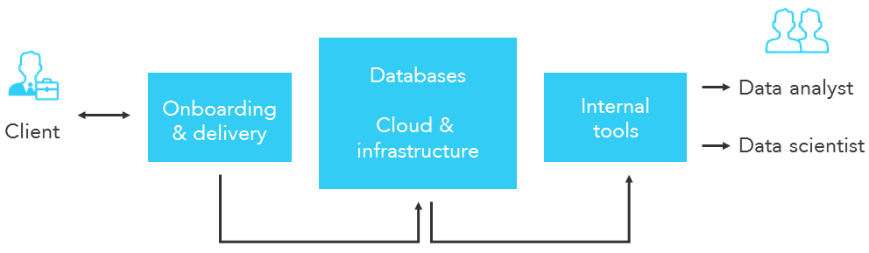
Data Engineer Responsibilities
Data engineers often work as part of an analytics team alongside data scientists.
The engineers provide data in usable formats to the data scientists who run queries and algorithms against the information for predictive analytics, machine learning and data mining applications.
Data engineers also deliver aggregated data to business executives and analysts and other end users so they can analyze it and apply the results to improve business operations.

Slide 24

Data Engineer Responsibilities
Data engineers deal with both structured and unstructured data.
Structured data is information that can be organized into a formatted repository like a database.
Unstructured data -- such as text, images, audio and video files -- doesn't conform to conventional data models.
Data engineers must understand different approaches to data architecture and applications to handle both data types.
A variety of big data technologies, such as open-source data ingestion and processing frameworks, are also part of the data engineer's toolkit.

Slide 25
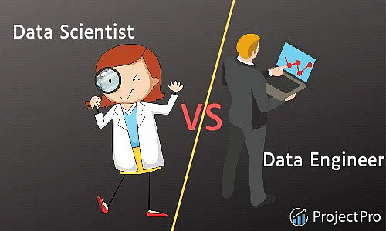
Data Engineer vs. Data Scientist
What is Data Engineering?
It consists of two terms- 'data' and 'engineering'.
"Data" refers to vast volumes of data generated from various sources.
"Engineering" relates to building and designing pipelines that help acquire, process, and transform the collected data into a usable form
What is Data Science?
"Data Science" is the art of transforming data into actions.

Slide 26
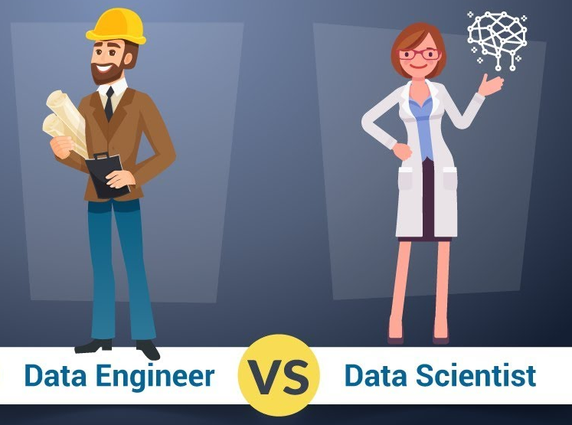
Data Engineer vs. Data Scientist
Data engineers and data scientists work together.
The data engineers prepare and organize the data that companies have in databases and other formats.
The data scientists use all that data for analytics and other projects that improve business operations and outcomes.
Data scientists tackle new, big-picture problems, while data engineers put the pieces in place to make that possible.

Slide 27
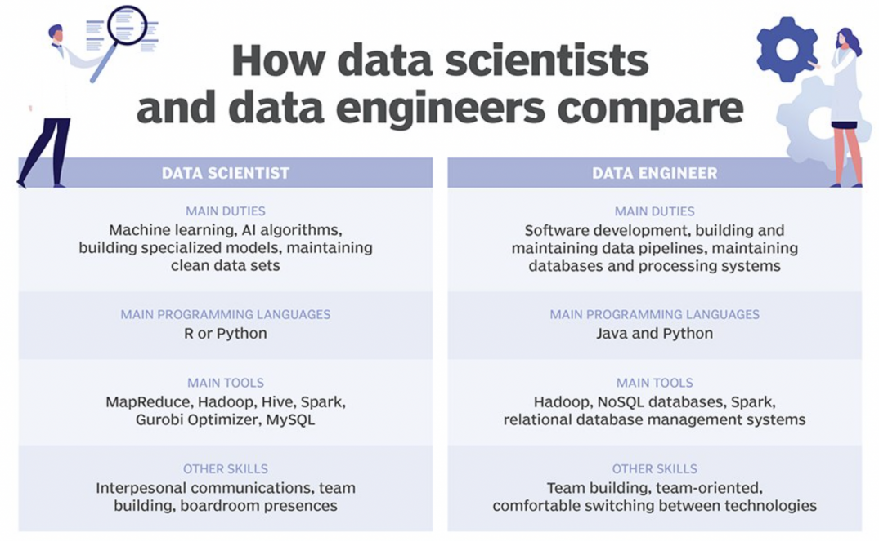
Data Engineer vs. Data Scientist

Slide 28
Data Engineer vs. Data Scientist - Skills
Data Science | Data Engineering
Data Science involves extracting information from raw data to derive business insights and values using statistical methods. | Data Engineering is associated with data collecting, processing, analyzing, and cleaning data. One may use the processed data in other processes like data visualizations, business analytics, etc.
Data Science looks into boosting the performance of a machine learning model. | Data Engineering handles the entire data pipeline's optimization and efficiency for sourcing data from the data warehouse.
Data Science creates and improves statistical analysis and machine learning predictive models for data analytics. It entails generating data visualizations and charts for analysis. | Data Engineering assists the Data Science team by implementing feature transformations with the help of big data technologies on datasets to train predictive models. It doesn't entail creating data visualizations.
Advanced-level understanding of mathematics, statistics, computer science, etc., is required to become a Data Science expert. It is not necessary to have expertise in programming. | Expert-level knowledge of programming, Big Data architecture, etc., is essential to becoming a Data Engineering professional. Having a broad knowledge of machine learning or statistics is optional.

Slide 29

References
https://www.coursera.org/articles/what-does-a-data-engineer-do-and-how-do-i-become-one
https://www.coursera.org/articles/data-engineer-vs-software-engineer
https://www.analyticsvidhya.com/blog/2022/03/a-quick-overview-of-data-engineering/
https://www.projectpro.io/article/data-engineer-vs-data-scientist-the-differences-you-must-know/430
https://www.guvi.in/blog/data-engineering-interview-questions-and-answers/
https://climbtheladder.com/data-engineer-vs-database-engineer/
https://intellipaat.com/blog/what-is-data-engineering/?US
https://www.eckerson.com/articles/data-engineering-coming-of-age
https://quanthub.com
https://www.techtarget.com
https://www.coursera.org

